Slide 1
ENHANCING FOOD SECURITY IN KARAMOJA
By Raphael Kubai

Slide 2
Introduction
Karamoja is the most food insecure region of Uganda and requires a data analyst to develop an interactive visualization tool of the results for this first crop season. The visualization tool to be developed will be used as a first mockup of the Food Security Monitoring tool that DDI will develop for the NGO.

Slide 3
Data Sources
Worksheets: Tabular data, such as:
Population data: Information on population size, distribution, across different sub-counties in Karamoja.
Area coverage data: Data on the extent of land areas dedicated to maize and sorghum in each subcounty in Karamoja.
Shapefiles: These are spatial data formats that represent geographic features such as geographical location and the crop types coverage which are maize and sorghum in the area

Slide 4
Methodology
Data cleaning and preparation – checked for consistency of the data in the worksheets and shapefiles
Spatial analysis – used spatial statistics to analyze the distribution of crop areas
Visualization – Created maps and charts to visualize the distribution of population, crop area and yields and represent the quantitative data and trends

Slide 5
Problem Statement
The lack of an efficient and accessible food security monitoring tool in Karamoja, Uganda, hinders the ability of NGOs to effectively prioritize their activities, allocate resources, and make critical decisions on the needs of farmers.

Slide 6
Objectives
To develop an efficient decision making tool for the food security in Karamoja
To provide understanding of the food security situation in Karamoja based on maize and sorghum distribution
To provide visualizations that allow NGOs to easily access and analyze the areas that need intervention effectively

Slide 7
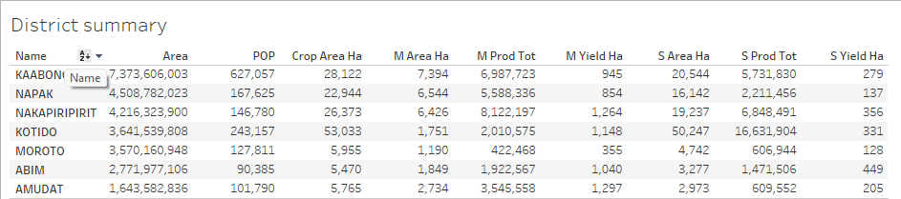
Karamoja Districts summary

Slide 8
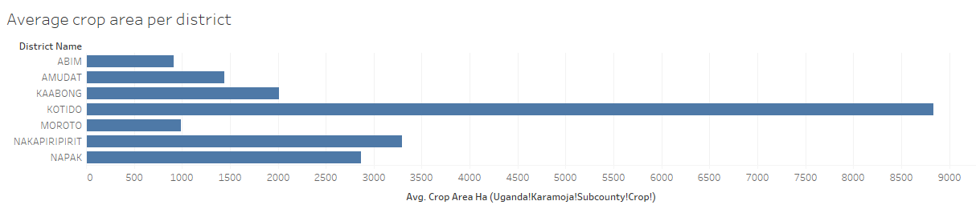
Average crop area per district

Slide 9
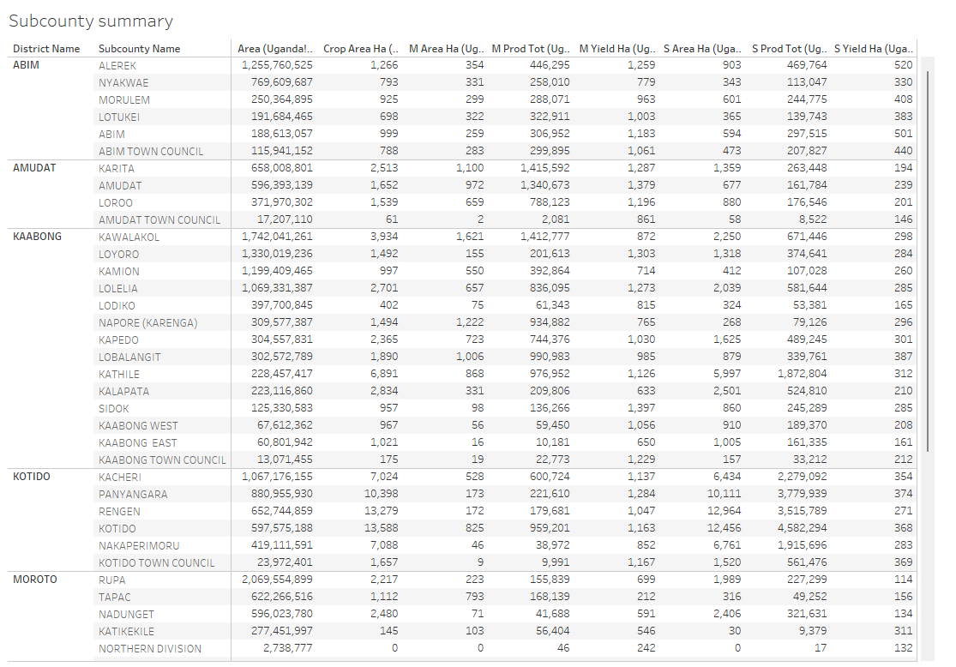
Subcounty summary data

Slide 10
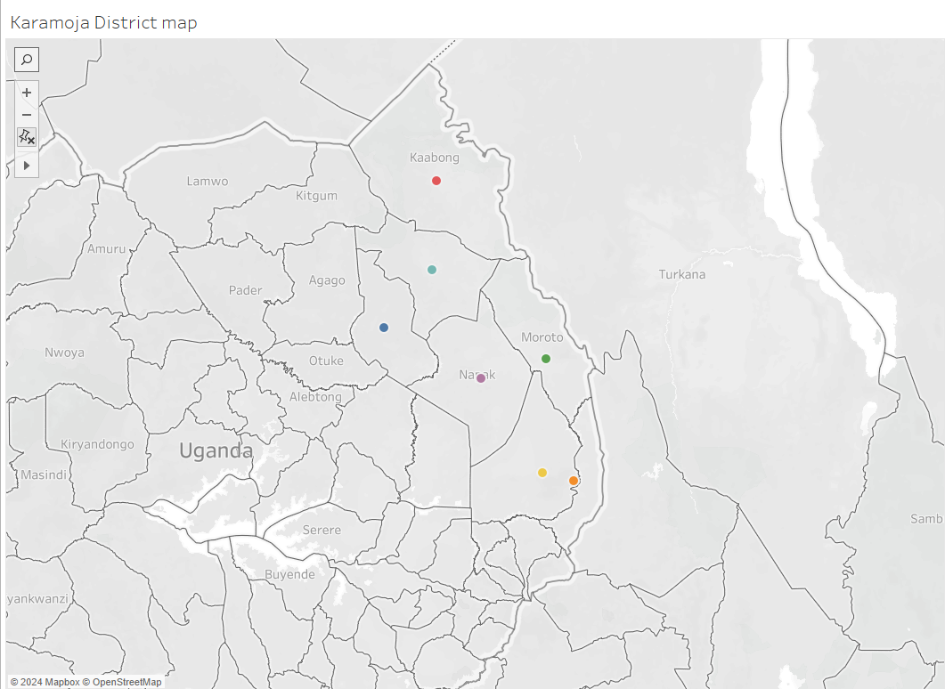
Karaamoja District Map

Slide 11
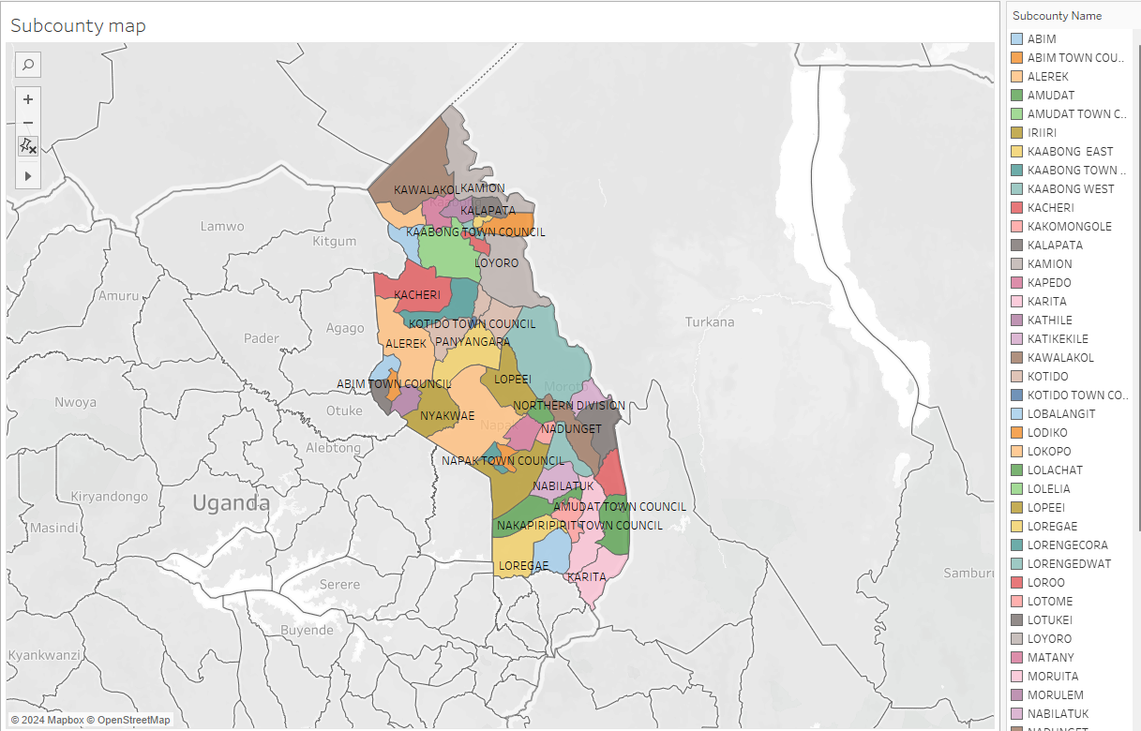
Subcounties map

Slide 12
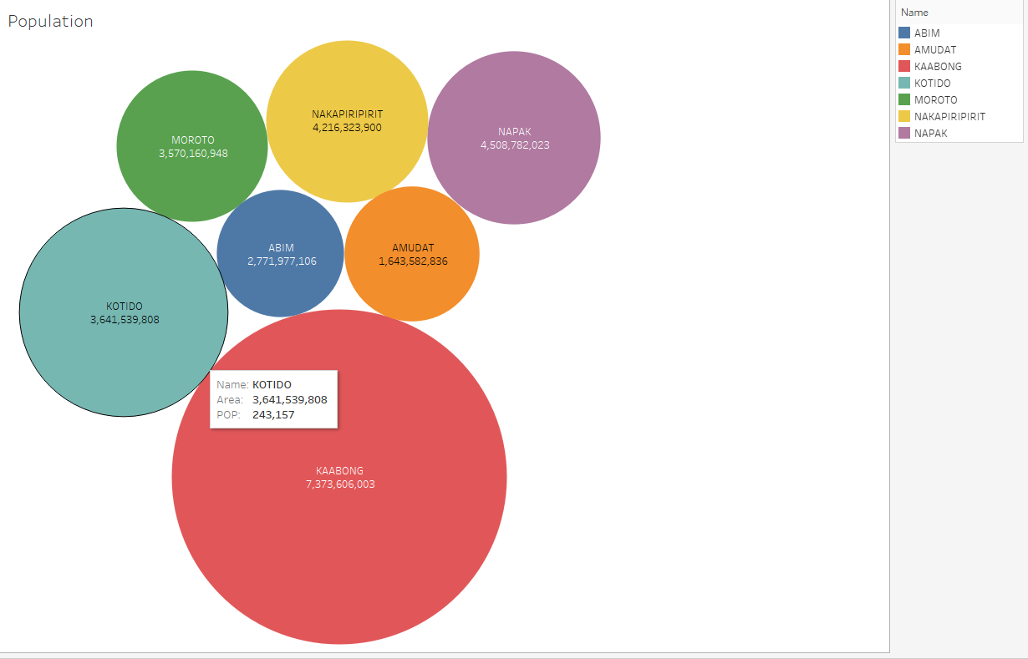
Karamoja population

Slide 13
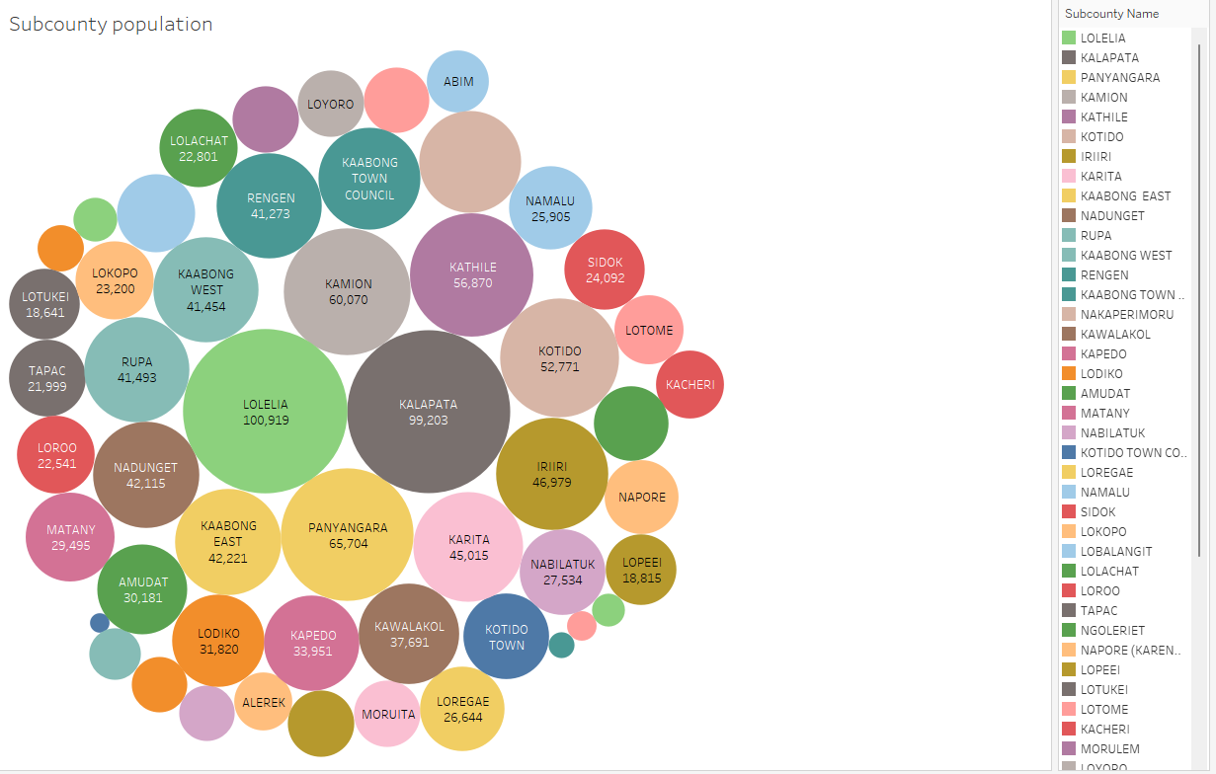
Subcounties population

Slide 14
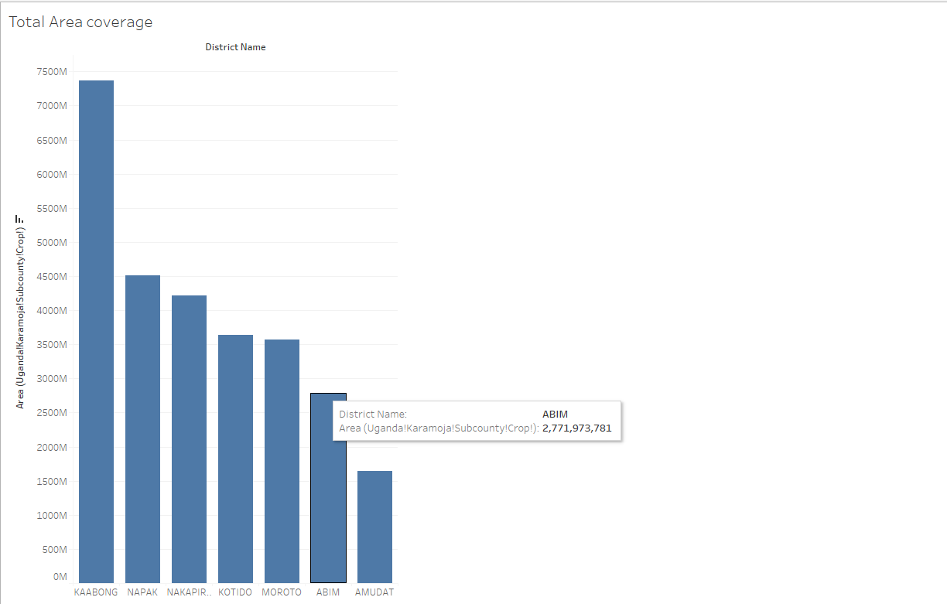
Total area coverage by each district

Slide 15
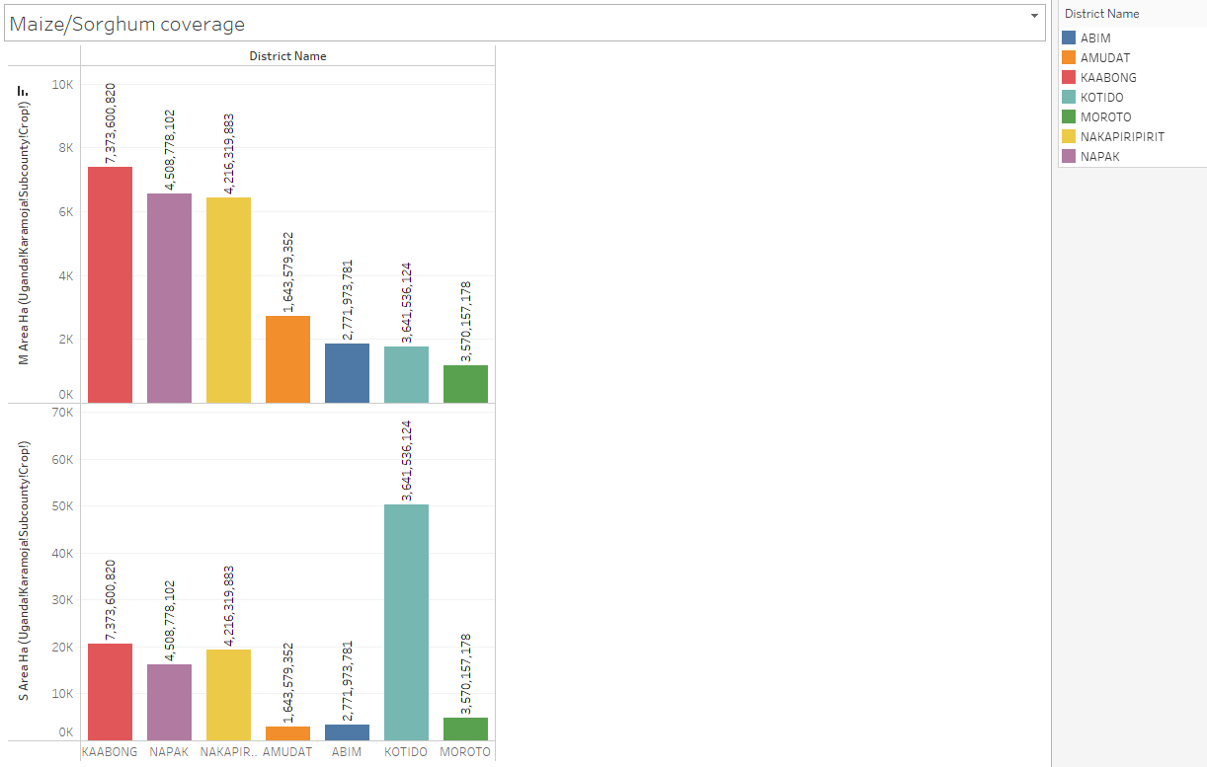
Maize/Sorghum coverage in Karamoja districts

Slide 16
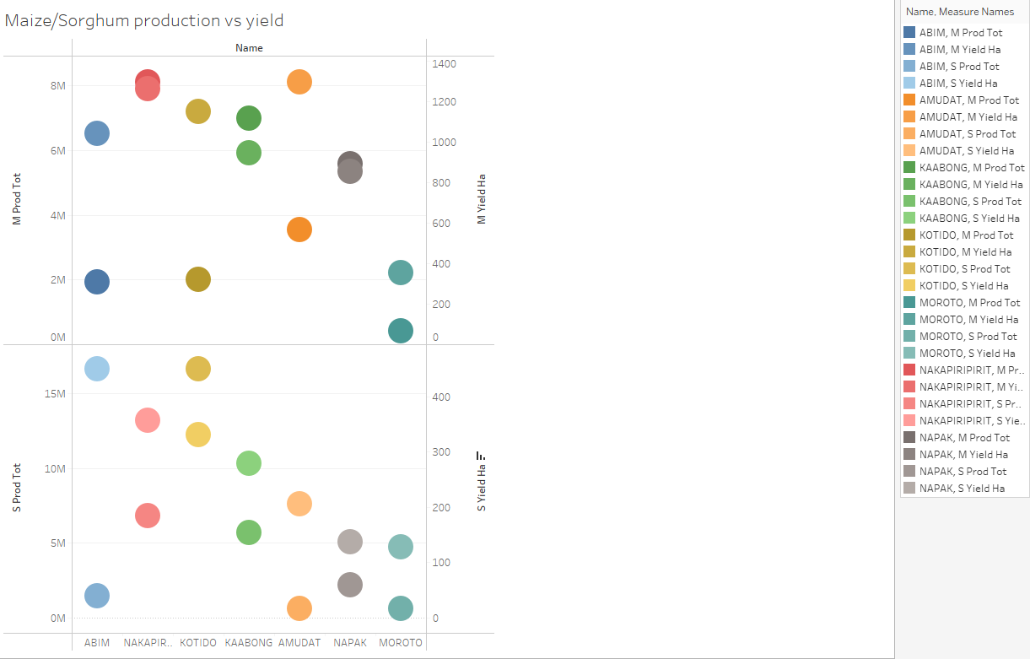
Maize and Sorghum yiels in subcounties

Slide 17
Conclusion
Based on the analysis of agricultural performance across the subcounties of Karamoja, it is evident that there is significant variation in productivity levels. There are districts such as Moroto which has a larger area than Abim and Amudat but has the lowest maize and sorghum production. In conclusion, some districts face challenges in achieving optimal results.

Slide 18
Recommendations
Improving farming practices by providing training on modern agricultural techniques
Promoting the use of high yielding seeds
Facilitating access to markets
Encouraging the production of value-added products

Slide 19
Future Work
Developing food security monitoring system
Improve data collection methods to enhance accurate and reliable analysis
Developing programs to empower the local community to participate in food security initiatives

